Slide 1


Gyanendriya : An AI Integrated Humanoid Robot
Project Category: Industry 4.0 & 5.0
Project ID: E-187-WM-I45-13
Presented at SRIJAN organized by R.G.P.V

Slide 2
Industry 4.0 – The Fourth Industrial Revolution
Focuses on automation, data exchange, and smart manufacturing
Core technologies:
Internet of Things (IoT)
Cyber-Physical Systems
Big Data & Analytics
Cloud Computing
Enables real-time monitoring and autonomous decision-making in production lines

Slide 3
Industry 5.0 – Human-Centric Innovation
Goes beyond efficiency to collaborate with humans
Emphasizes:
Human-robot collaboration
Empathy, personalization, and well-being
Sustainable and resilient technologies
Brings intelligence with empathy, combining AI and human creativity

Slide 4
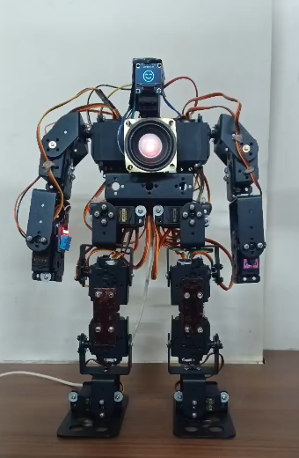
Introducing Gyanendriya
AI-powered humanoid robot for real-time interaction
Accepts voice and Bluetooth commands
Modular 3-ESP32 system for brain, voice, and movement control

Slide 5
Identified Problem in Industry 4.0
Industrial bots lack human-like interaction
No emotional intelligence or empathy
Can't flexibly adapt to dynamic, unpredictable scenarios

Slide 6
How Gyanendriya Solves This ?
Multimodal command input: Voice & Bluetooth (text/voice)
Uses IR sensor to auto-trigger listening mode
OLED for facial expressions; servos for body gestures
Gemini handles complex decision making

Slide 7
Features and Capabilities
01
02
03
Bluetooth control via mobile app
04
05
06
Movements: dance, hug, handshake, pick/drop, swag
Voice interaction using STT + TTS
OLED for emotional display
Play live radio and news
Human-like Interaction

Slide 8
Applications in Industry
Industry 4.0:
Voice-controlled automation assistant
Hands-free operation in factories
Industry 5.0:
Emotionally intelligent human-robot collaboration
Personalized assistance and service roles

Slide 9
Real-World Use Cases
Educational tutor for interactive learning
Healthcare assistant for elderly/patients
Customer support in banks, malls, hotels
Smart factory bot for reporting & interaction

Slide 10
Project Impact
Bridges the gap between emotionless automation and human needs
Demonstrates synergy of AI, robotics, and empathy
A modular, scalable platform for diverse industries

Slide 11
Future Scope
Facial recognition & user profiling
Emotion analysis for more empathetic interaction
Autonomous indoor mapping and navigation
Integration with cloud AI for smarter learning
IoT-based home/office automation integration

Slide 12

Architecture Overview
ESP32-1 (Brain): STT, IR sensor, SD card, OLED, mic
ESP32-2 (Voice): TTS, speaker, plays radio/news
ESP32-3 (Movement): Motor driver & servos

Slide 13
Technologies Used
Hardware | ESP32, MG995 Servo, PCA9685, OLED, MAX98357, IR Sensor
Software | Arduino IDE, STT (Deepgram), TTS (Google), Gemini
Communication | UART, I2C, I2S, Bluetooth

Slide 14
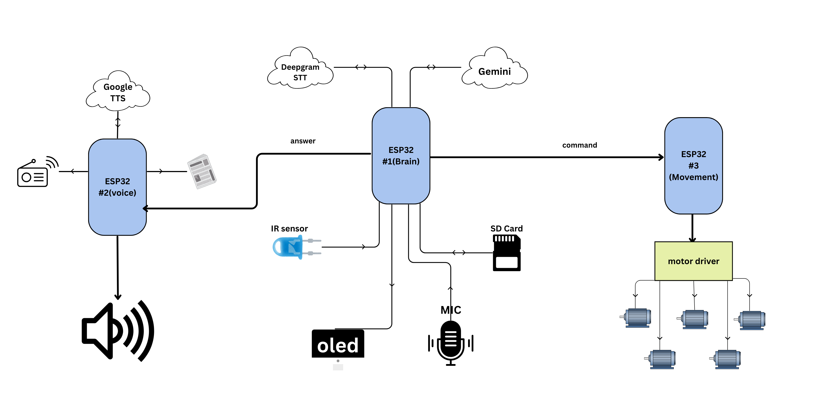
Workflow & Flowchart

Slide 15
THANK YOU

